Slide 1




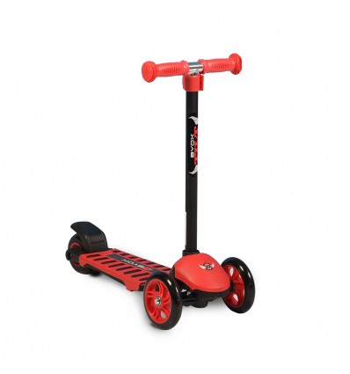
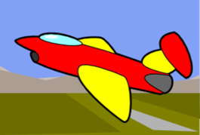
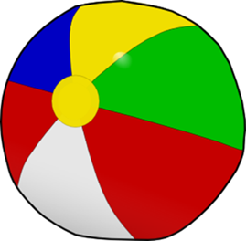
Many, many toys!

Slide 2

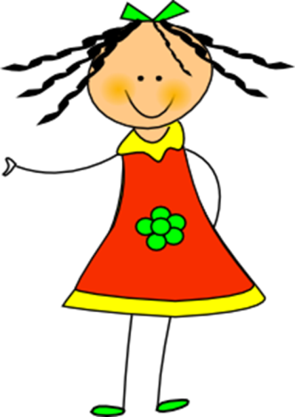



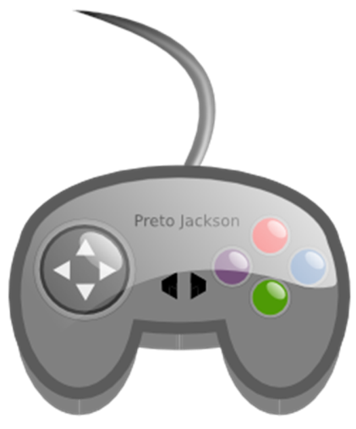


Listen, point and say

Slide 3

Let’s play a guessing game!

Slide 4


Is it an aeroplane?

Slide 5

Yes, it is.

Slide 6


Is it a car?

Slide 7

No, it isn’t.

Slide 8


Make a question.

Slide 9

Answer the question.

Slide 10




Slide 11



Slide 12

Let’s play!
Click on the link below:
http://www.quia.com/jg/3114018.html

Slide 13
Listen to the chant!
This is my doll,
this is my doll
It’s big and tall!
This is my car,
this is my car
It’s red and black!

Slide 14

Let’s say the chant!

Slide 15

Let’s sing 10 little aeroplanes!
Click here:
https://youtu.be/4J5ywWdp_-M

Slide 16

Listen!
This is my teddy!
It’s brown!
I like my teddy!

Slide 17

Let’s make a poster!
Draw your favourite toy!
Say 2-3 sentences, like the example.

Slide 18
Images courtesy of:
http://www.clker.com
clipart-library.com

