Slide 1
Places in a town

Slide 2
Let’s remember these:

Slide 3
And these from last year:

Slide 4
Now LET’S PLAY!
Click below to play a hangman game:
https://www.eslgamesplus.com/places-around-esl-vocabulary-interactive-hangman-game/
Have fun!!!
Click below to play a word search game:
https://www.freddiesville.com/games/places-around-vocabulary-word-search-puzzle-online/

Slide 5
Now let’s read

Slide 6
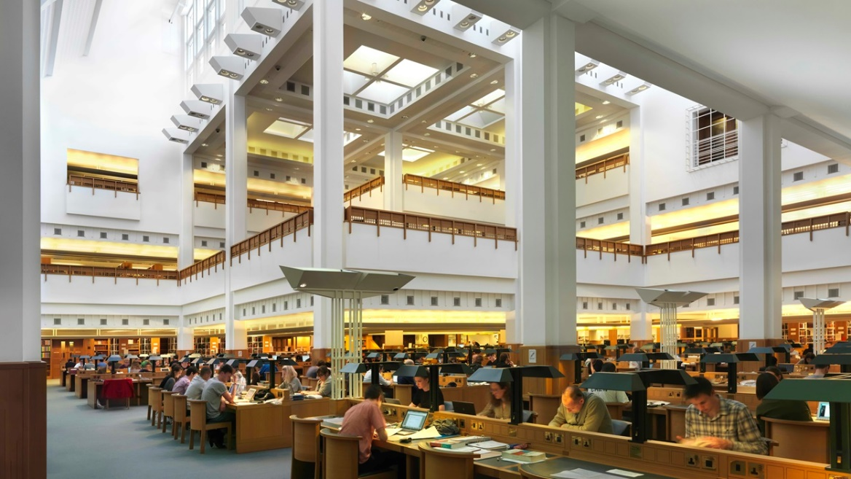
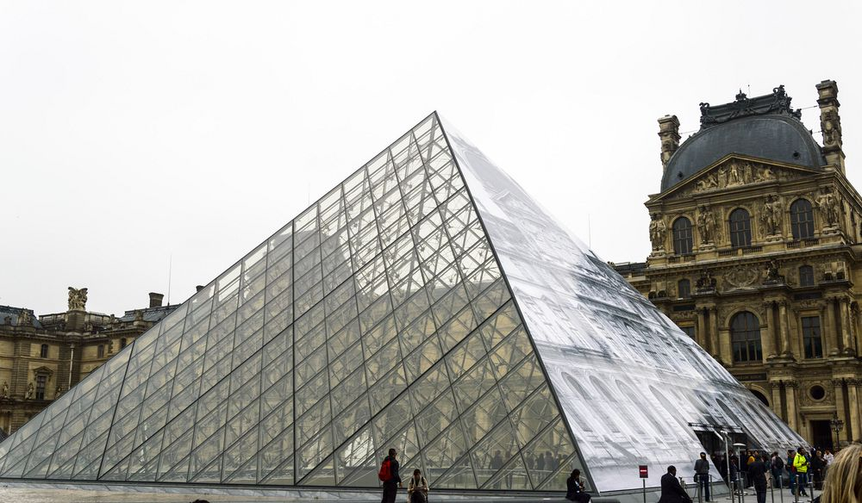
World’s biggest:
The British Library is the National Library of the United Kingdom. It is the largest library in the world. It has about two million items (books, newspapers, maps etc) from all over the world.
The Louvre Art Museum is the largest art museum in the world with a gallery space of 72,735 square metres. It is in Paris. The Louvre is also the most visited museum in the world, receiving 7.4 million visitors every year. One of the most famous paintings that people can see there is “Mona Lisa” painted by Leonardo Da Vinci.

Slide 7
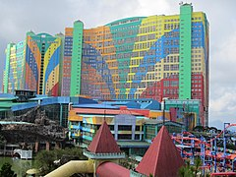
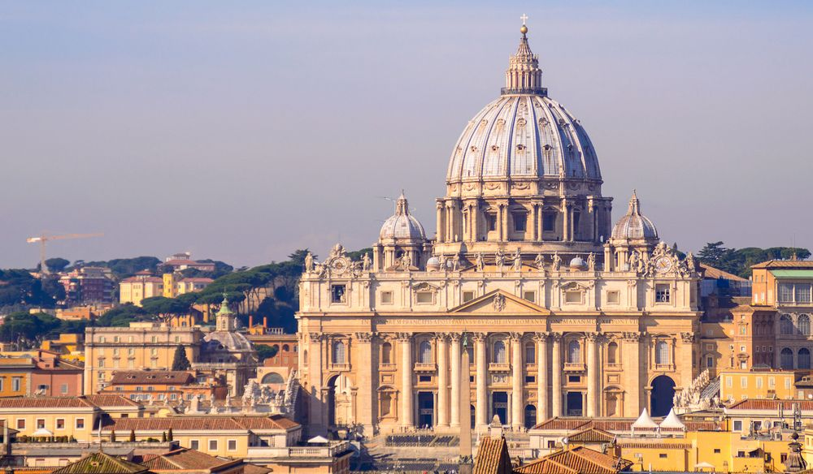
St. Peter’s Basilica in Vatican City, in Rome, is said to be the biggest church in the world. The inside of the church was painted by famous artists like Michelangelo and Bernini. It is one of the most important places to visit in Rome.
The “First World Hotel” has the Guinness World Record for the biggest hotel in the world. It is a three star hotel in Malaysia. It has 36 floors with the total of 7,351 rooms.

Slide 8
Let’s check your memory:
Good Luck!!!
Click below and do the quiz
http://www.quia.com/quiz/7650126.html

Slide 9
Can you find out about more interesting places around the world?
Here are some ideas:
The oldest operating theatre
https://www.worldatlas.com/articles/which-is-the-oldest-theater-in-the-world.html
The biggest cinema
https://www.worldatlas.com/articles/which-is-the-largest-cinema-in-the-world.html
The biggest archaeology museum
http://www.bbc.com/travel/story/20181101-in-egypt-the-worlds-largest-archaeology-museum
Can you make a poster about the place you liked more?

Slide 11
Images courtesy of:
https://www.bl.uk/visit/reading-rooms
https://www.worldatlas.com/articles/the-largest-art-museums-in-the-world.html
https://www.worldatlas.com/articles/the-largest-churches-in-the-world.html
https://en.wikipedia.org/wiki/First_World_Hotel_%26_Plaza

