Slide 1
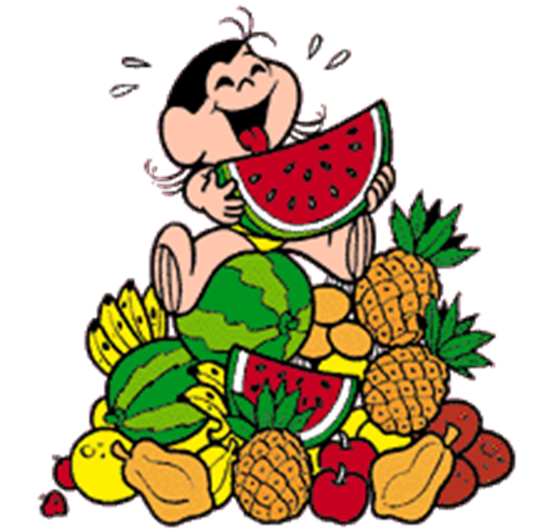
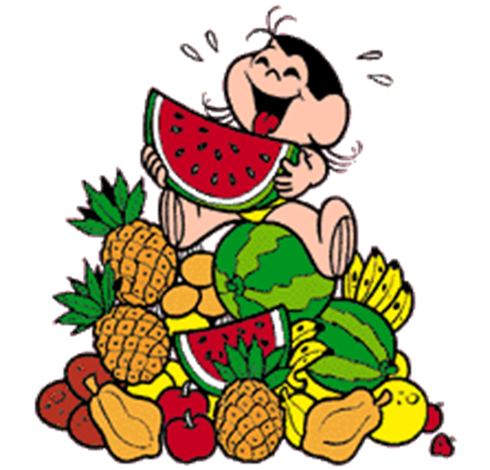
Food

Slide 2
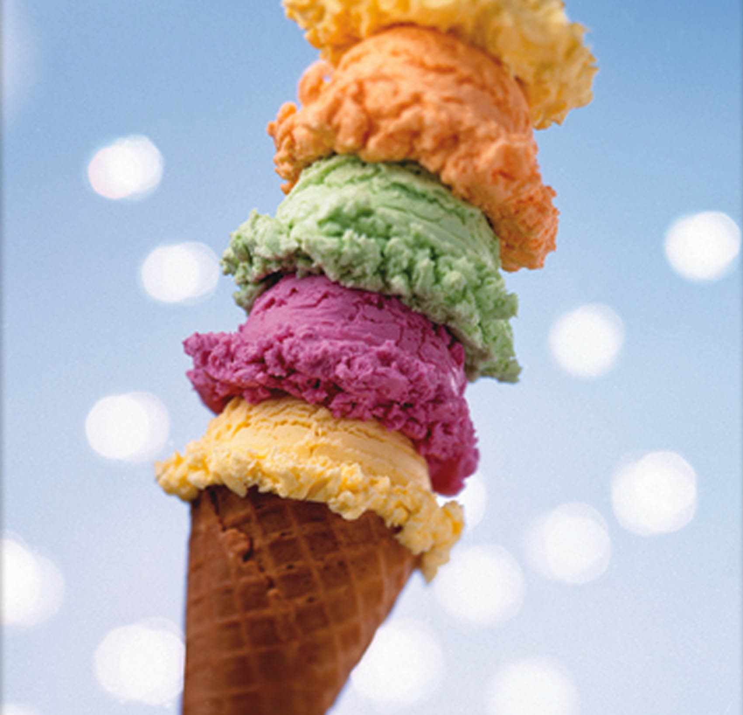
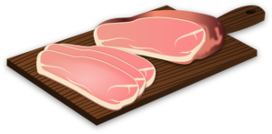
Let’s remember!
chips
coffee
ice-cream
pizza
milk
hamburger
cheese
water
ham
cake
egg
tea

Slide 3
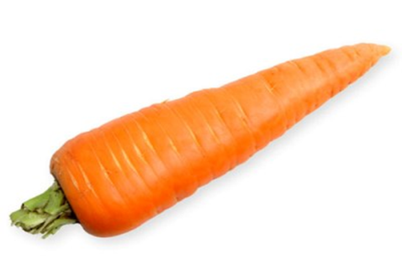
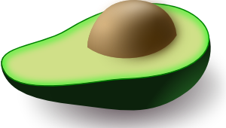
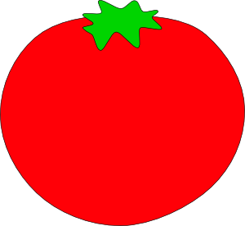
carrot
apple
pear
banana
avocado
orange
tomato

Slide 4
I like pizza.
I don’t like cake.
I like cheese.
I don’t like milk.

Slide 5
What do you like?
I like…
I don’t like…

Slide 6
Let’s sing a funny song!
Click on the link below:
https://www.youtube.com/watch?v=frN3nvhIHUk

Slide 7
Let’s do a quiz!
Are you ready?

Slide 8
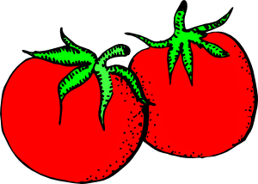
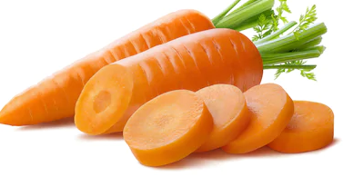
Click on the right picture!
I like carrots

Slide 9
TRUE
CONTINUE THE QUIZ

Slide 10
FALSE
CONTINUE THE QUIZ

Slide 11
I don’t like coffee

Slide 12
TRUE
CONTINUE THE QUIZ

Slide 13
FALSE
CONTINUE THE QUIZ

Slide 14
I like pears

Slide 15
TRUE
CONTINUE THE QUIZ

Slide 16
FALSE
CONTINUE THE QUIZ

Slide 17
I don’t like tea

Slide 18
TRUE
CONTINUE THE QUIZ

Slide 19
FALSE
CONTINUE THE QUIZ

Slide 20
I like cheese

Slide 21
TRUE
CONTINUE THE QUIZ

Slide 22
FALSE
CONTINUE THE QUIZ

Slide 23
I like pizza

Slide 24
TRUE
CONTINUE THE QUIZ

Slide 25
FALSE
CONTINUE THE QUIZ

Slide 26
I don’t like chicken

Slide 27
TRUE
CONTINUE THE QUIZ

Slide 28
FALSE
CONTINUE THE QUIZ

Slide 29
I like cakes

Slide 30
TRUE
CONTINUE THE QUIZ

Slide 31
FALSE
CONTINUE THE QUIZ

Slide 32
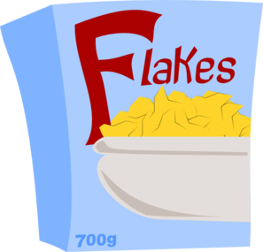
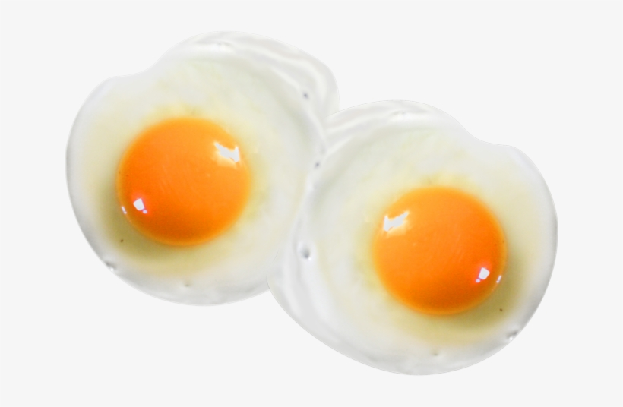
I don’t like eggs

Slide 33
TRUE
CONTINUE

Slide 34
FALSE
CONTINUE

Slide 35
Let’s play!
Clicks on the links below:
http://www.quia.com/jg/3110590.html
https://learnenglishkids.britishcouncil.org/word-games/food-1

Slide 36
Creative activity

Slide 37
Take a piece of paper
Draw your favourite food
Write sentences like the example

Slide 38
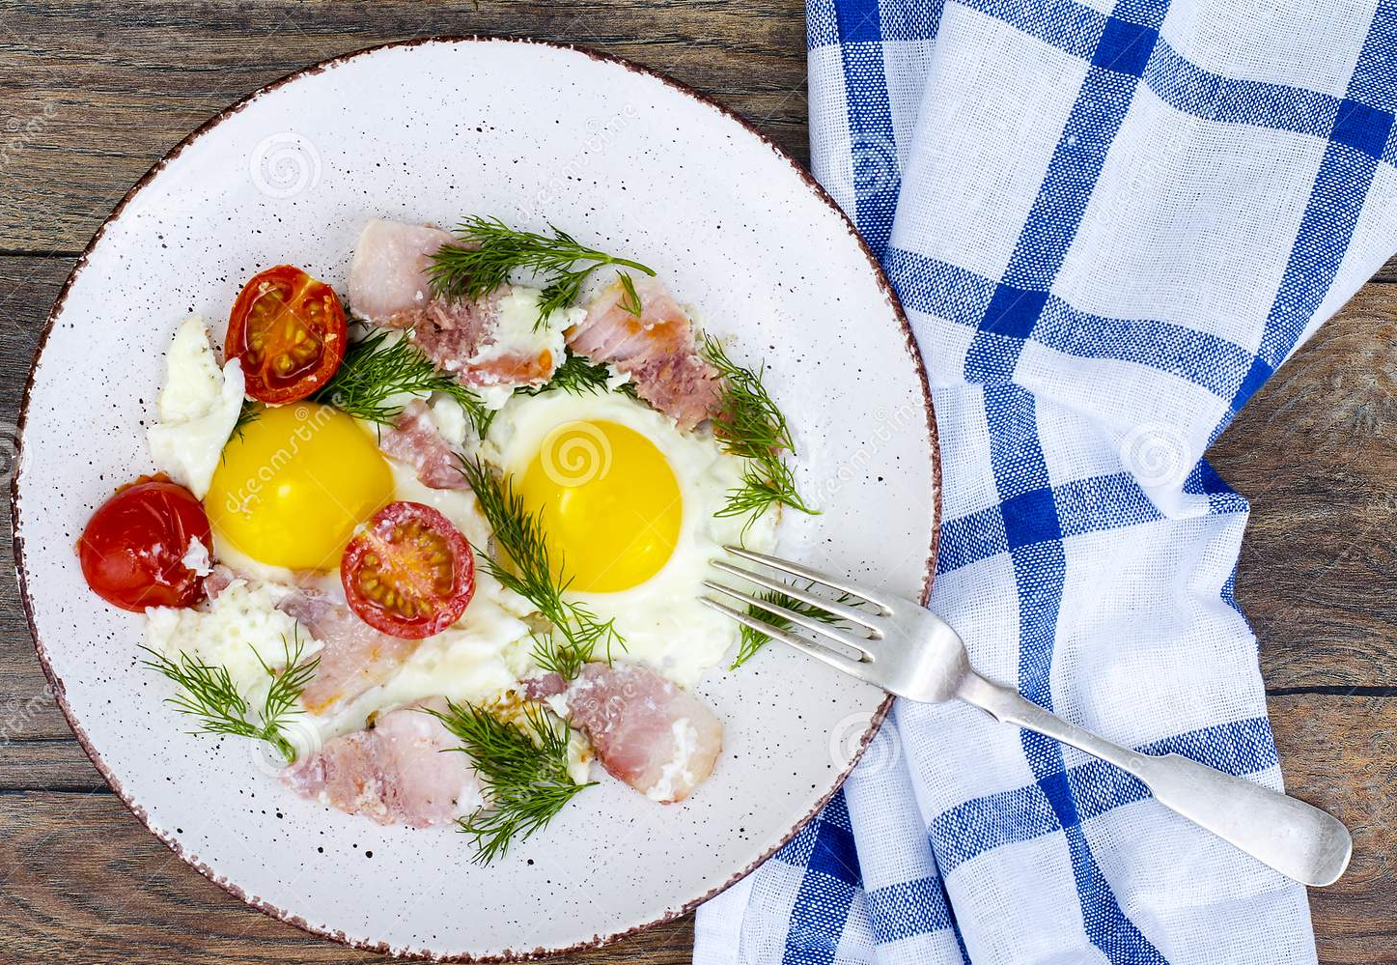
I like tomatoes. I like ham and eggs, too!

